Slide 1
How to edit and change a default Alma Analytics dashboard using the archive method
Yoel Kortick
Senior Librarian

Slide 2

Agenda
Introduction
The sample use case
The steps
Checking and testing the results

Slide 3
Introduction

Slide 4
Introduction
There may be cases where the institution wants to make changes to a default Alma Analytics Dashboard.
In this case the default Alma Analytics Dashboard can be archived from the Alma folder and then unarchived into the institution folder.
In the institution folder all links from the reports and directories will also be copied and the links to the dashboard from the reports and prompts will be from the institution folder.

Slide 5
Introduction
Using the archive method, the links to reports and prompts in the institution’s folders will not need to be remade.
This is an advantage over merely copying the Alma Analytics default dashboard to the institution's folder.
When the Alma Analytics default dashboard is copied (not archived) to the institution's folder then the links to the institution’s folders will need to be remade.

Slide 6
The sample use case

Slide 7
The sample use case
In the example here we will copy the “Title level overlap analysis” dashboard and all related reports and prompts.
The “Title level overlap analysis” is in folder “/shared/Alma/Titles/Dashboards”
We will copy the entire folder “/shared/Alma/Titles/” from the “Alma” folder to the institution’s folder.
In our case the name of the institution’s folder is “Demo Alma University”

Slide 8
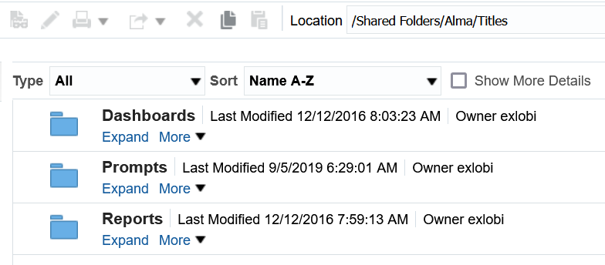
The sample use case - Search
We will copy this entire folder
These subfolders will also be copied

Slide 9
The steps

Slide 10
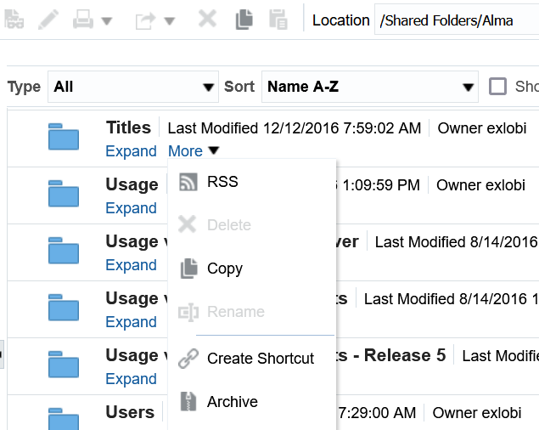
The steps
Do “More > Archive” on the folder you want to copy

Slide 11
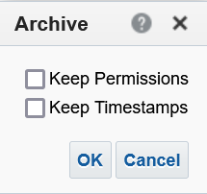
The steps
After doing “More > Archive” you will be presented with the following dialog box.
Just click OK

Slide 12
The steps
This will download a file called “[Name of folder].catalog” to your PC.
Depending on browser definitions, the file will either be automatically downloaded, or the user will be prompted to save the file in a specific directory on the PC.
In any case, the file will be saved on the PC.

Slide 13
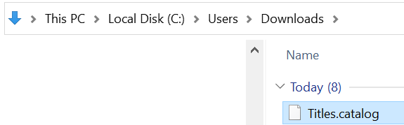
The steps
The file has been saved to the PC

Slide 14
The steps
Now go to the directory under your institution’s folder where you want the copied version of the dashboard to be, and “unarchive” the file we just archived.
We will put it in a newly created folder called “Local Titles Dashboard” which is under our institution’s folder “Demo Alma University”.
While selecting the folder do “More > Unarchive” and then choose the archived file we just now saved on the PC

Slide 15
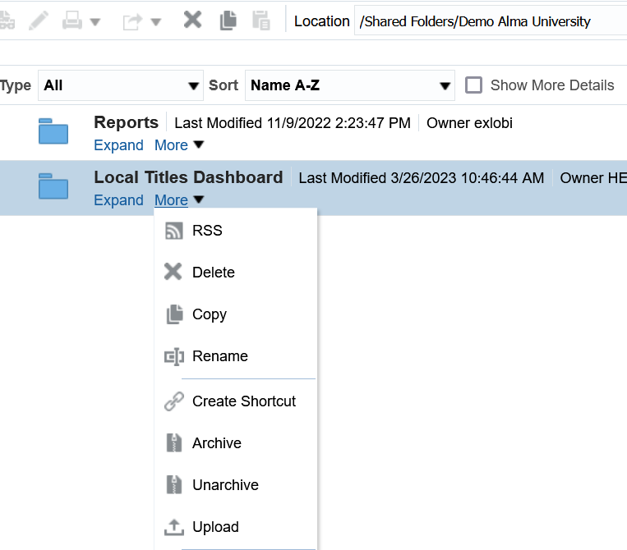
The steps
We will select “Unarchive”

Slide 16
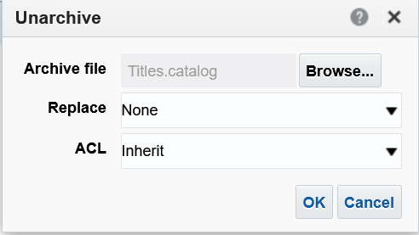
The steps
After selecting “Unarchive” we are prompted to load the file which we archived.
Click “Browse” to get the file. Leave the other fields as they are.
Click OK
We already browsed and got the file
We will click OK

Slide 17
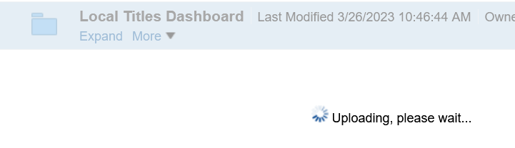
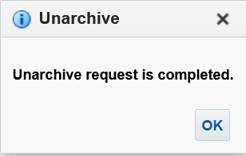
The steps
The archive file will be uploaded and completed.

Slide 18
Checking and testing the results

Slide 19
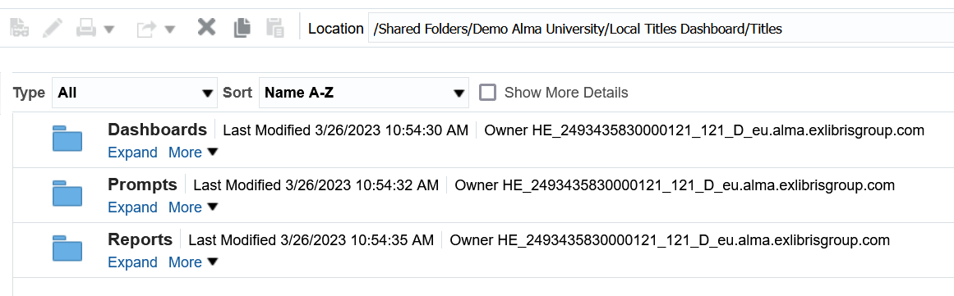
Checking and testing the results
Under the folder “Local Titles Dashboard” the “Titles” folder has been copied with all three subfolders

Slide 20
Checking and testing the results
To confirm that the files under “Reports” and “Prompts” under “Demo Alma University/Local Titles Dashboard” are being used (and that we do not need to redo the links) we will change two report from the “Reports” folder and then confirm that they are being used in the copied dashboard

Slide 21


Checking and testing the results
In the “Reports” folder in report “Overlap P and E” we change the header “Title” to “Title of record”
Before
After

Slide 22
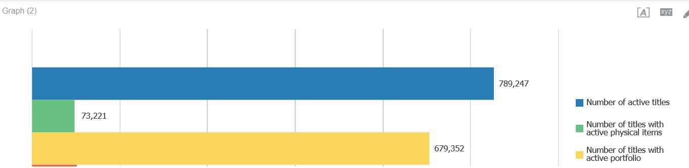
Checking and testing the results
In the “Reports” folder in report “Inventory Breakdown” we change the “Number of active titles” to be after “Number of titles with active physical items
Before

Slide 23
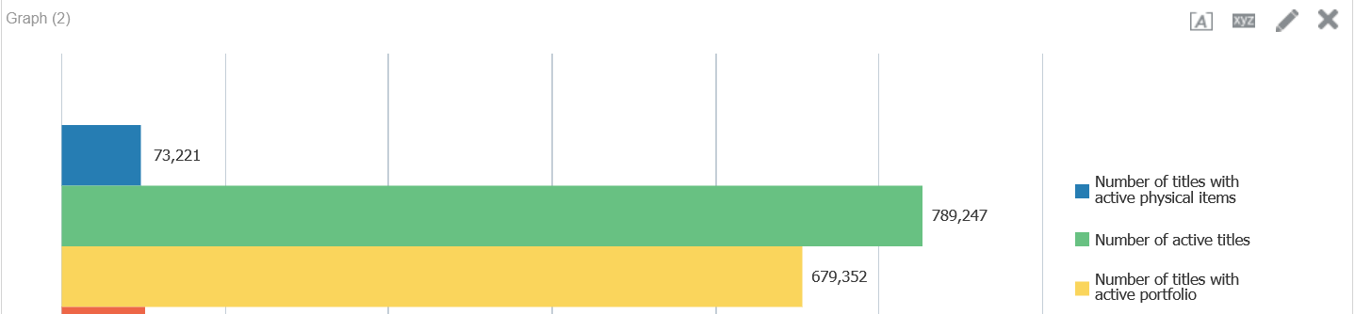
Checking and testing the results
In the “Reports” folder in report “Inventory Breakdown” we change the “Number of active titles” to be after “Number of titles with active physical items
After

Slide 24
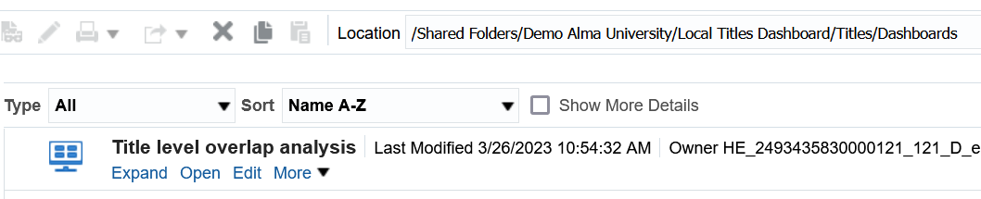
Checking and testing the results
Now let’s open the copied dashboard and confirm that our changes are there

Slide 25
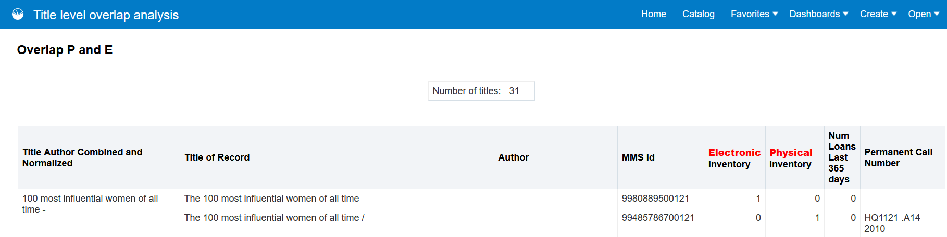
Checking and testing the results
Here is the first change

Slide 26
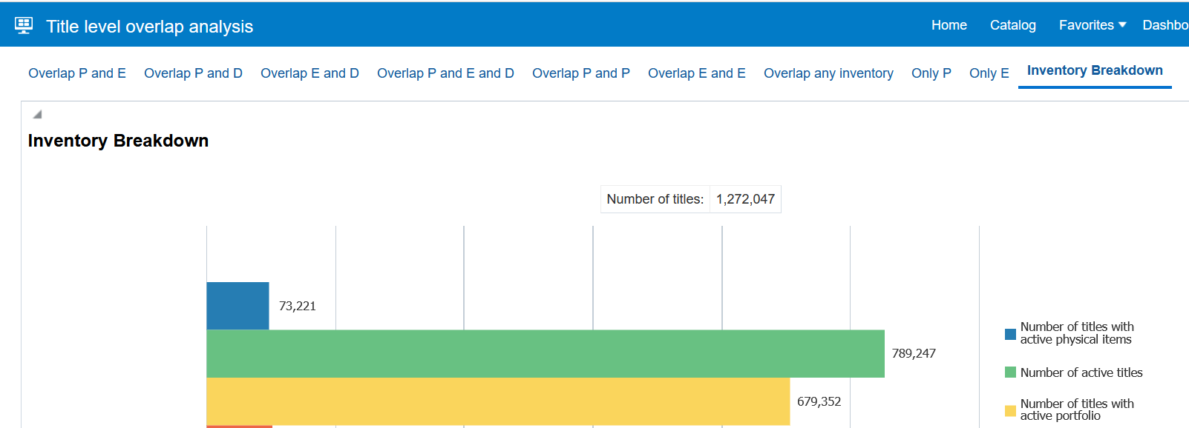
Checking and testing the results
Here is the second change

